Slide 1
How to build a Rain Garden
Growing Communities Greener

Slide 2
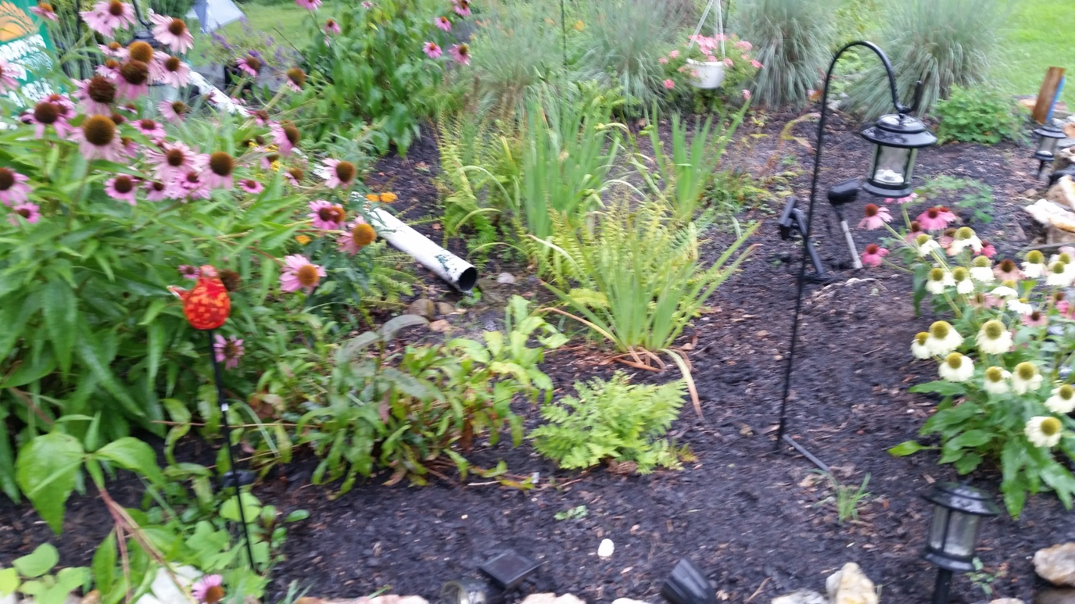
What is a Residential Rain Garden
A shallow indentation landscaped with deep rooted native vegetation that filters rainwater directed from impervious surfaces, like rooftops, via downspouts.

Slide 3
Your Personal Contribution to Cleaner Water
Reducing stormwater runoff:
Increases water that filters into the ground
Protects communities from flooding and drainage issues
Protects our waterways from pollutants
Fertilizers, oils, debris, sediments,
Aesthetic beauty-increases property values
Provides habitat for birds, bees, butterflies

Slide 4
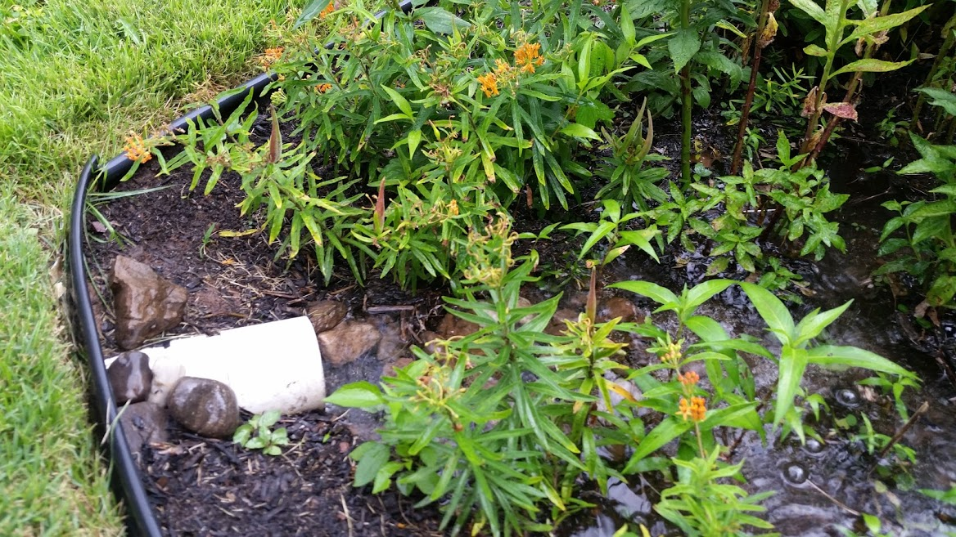
What Rain Gardens Do
Pollutants retained
Taken up by plants (nitrogen, phosphorus)
Absorbed by mulch, soils or organic matter (metals)
Broken down by micro-organisms and sunlight (hydrocarbons, bacteria)
Reduction in storm water volume
Infiltration
Evapotranspiration
Filtration of course particles
Sediment
Bacteria

Slide 5
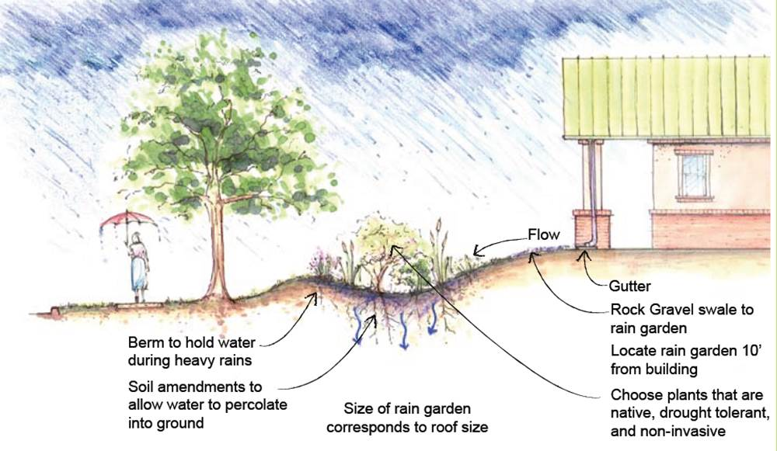

Slide 6
Frequently Asked Questions
Rain gardens should not form ponds, they are meant to infiltrate stormwater.
They do not breed mosquitoes. They are built to infiltrate water within 12-48 hours.
Rain gardens should not require any more maintenance than regular flower beds. Proper mulching the first 2 years will decrease weeding.
Rain gardens don’t have to be expensive. Typically $3-5 sq ft self built, $17-20 sq ft contracted.

Slide 8
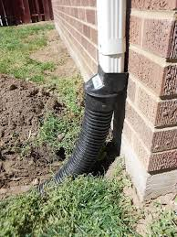
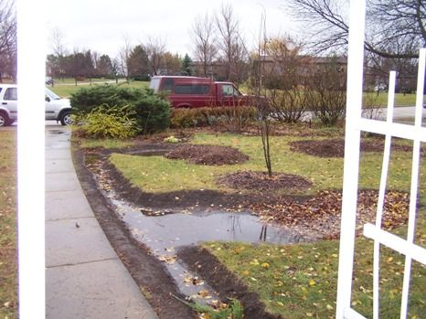
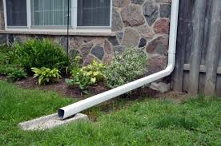
Design Process Step 1
Identify potential rainwater sources and how to direct them into the garden.
A downspout or combination of downspouts from your roof.
Runoff that flows onto your property from your driveway, walkways, or patios as well as neighboring patios or driveways.

Slide 9
Design Process Step 2
Measure the areas that will collect the water to determine water volume.
Roof and impervious surfaces

Slide 10
Design Process Step 3
Determine where to locate your rain garden.
Should be at least ten feet from a foundation
Integrate with your landscaping
Sunny or partly sunny locations are best, but a shade garden is possible
Should not be located where water ponds
The flatter the site the better: less than 12% slope
Determine slope
Do not locate over septic system
Avoid building under large trees
Consider the downspout that drains the most roof runoff
Plan where the overflow will go

Slide 11
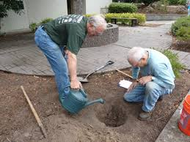
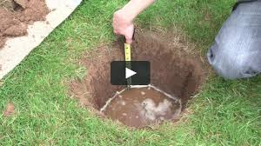
Design Process Step 4
Test your soil to determine its infiltration rate.
Your soil must drain at least 1 /4 inch of water per hour to be suitable for a rain garden.
Infiltration Test
The ideal soil for a rain garden is high in sand and silt.
Soil remediation with compost or sand

Slide 12
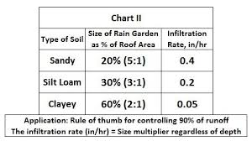
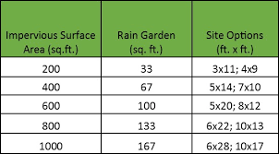
Design Process Step 5
Size the garden area and depth.
Typical size is 100-300 sq feet. Based on a 1”storm
Square footage of drainage area/depth of raingarden ie: 450 sq ft/6” = 75 sq ft raingarden
Design area should be level and flat.
Average is 4-8” deep
>12” most plants can’t tolerate.
3”or less needs to be very large to hold water
Berms keep the water contained.
Inflow and overflow points.

Slide 13
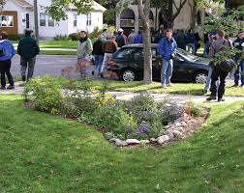
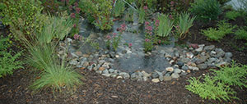
Design Process Step 6
Determine the shape and general appearance of the garden in the existing landscape.
Keep the ratio of length to width at least 2:1
Kidney, oval, teardrop
Longer length perpendicular to inflow

Slide 14
Installation
Call 811 PA one-call to identify utilities

Slide 15
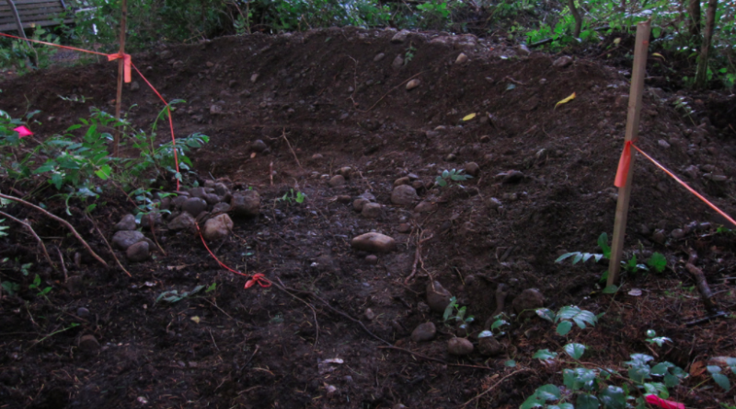
Installation
Outline site with spray paint
Remove grass
Dig Rain garden

Slide 16
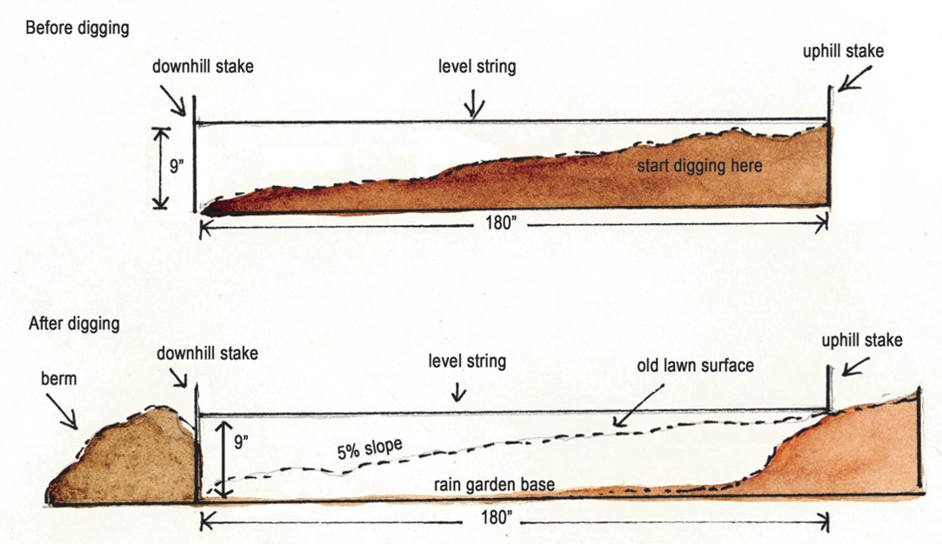
Installation
Dig out and level the bottom to the correct depth based on rain garden sizing
Account for 3” of mulch on top

Slide 17
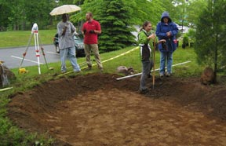

Slide 18
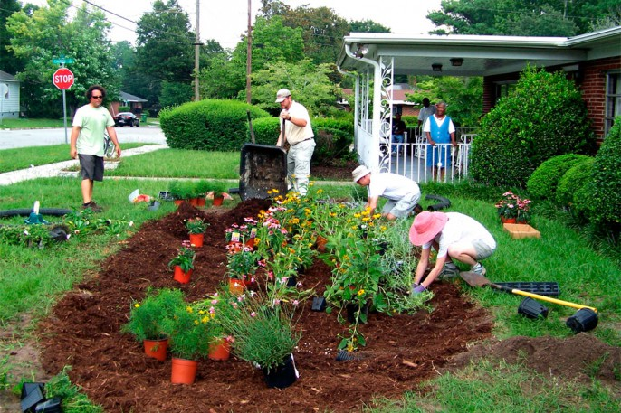
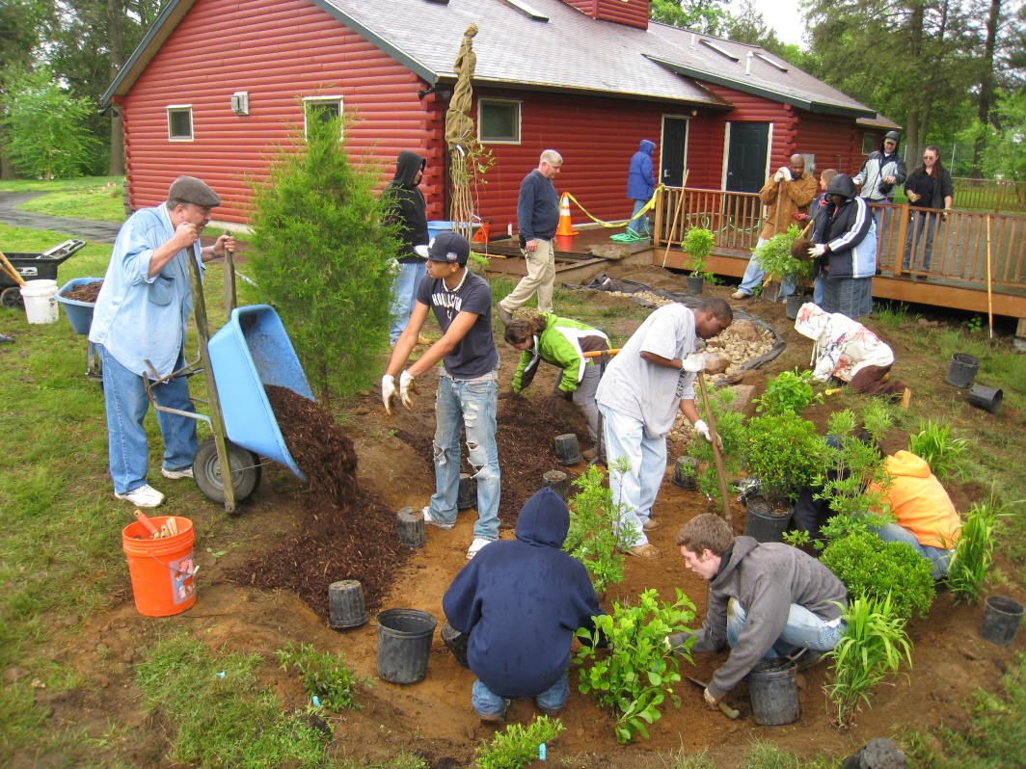
Installation
Use the excess soil to build the berm at the low end.

Slide 19
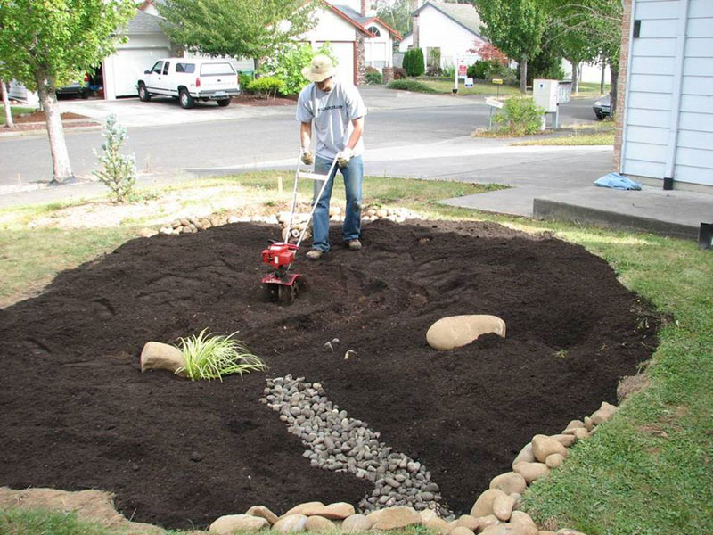
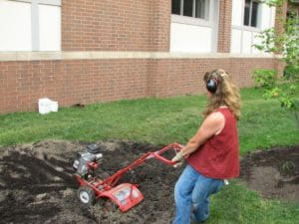
Installation
Till the soil and amend as necessary with a sand and compost mixture.

Slide 20
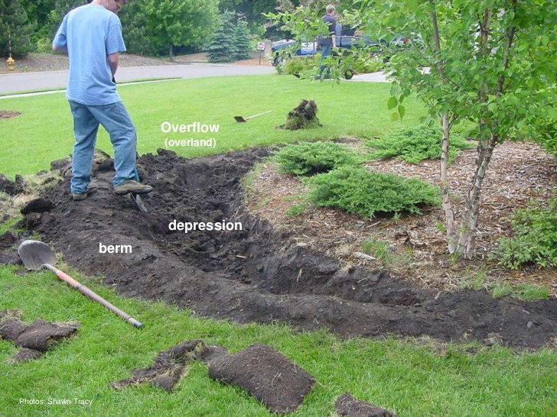
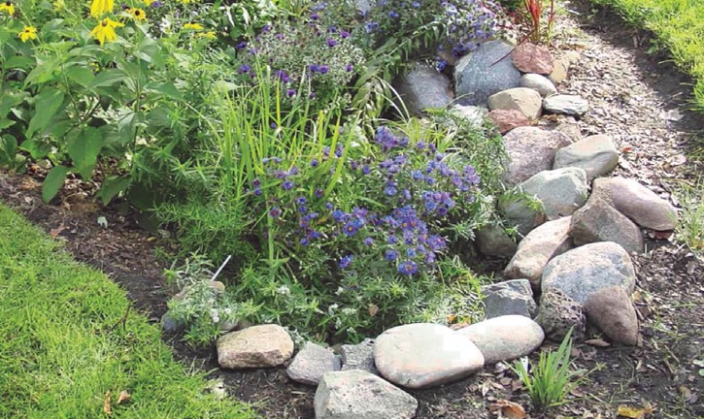
Installation
Prepare the overflow
High enough to allow the rain garden to fill to required depth but lower than the inlet to prevent backing up.
Must include erosion protection
River rocks etc

Slide 21
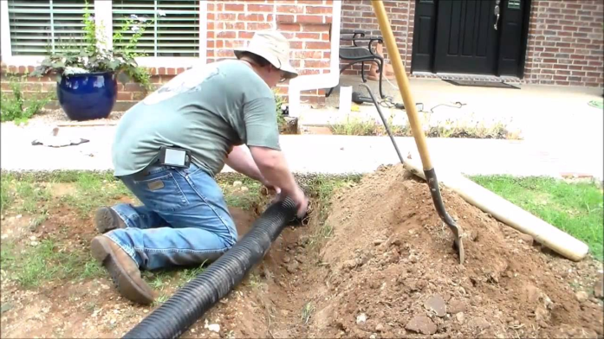
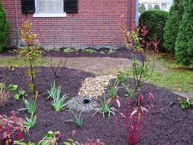
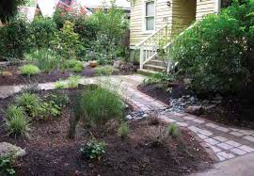
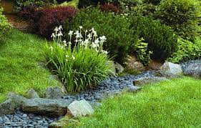
Direct Water to the Rain Garden
Run a path from the downspout to the rain garden
Bioswale, corrugated underground piping

Slide 22
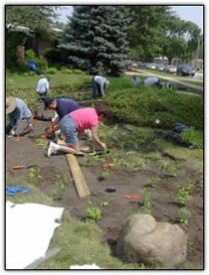
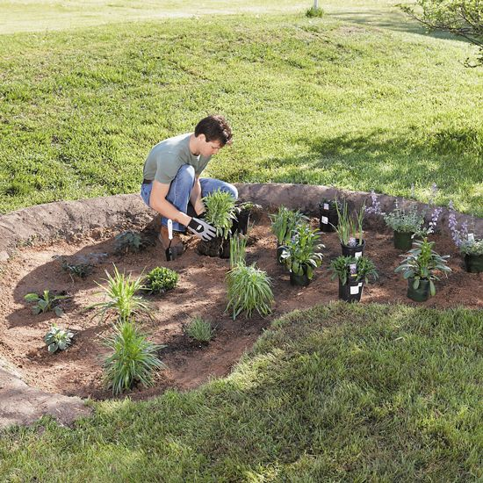
Plant the Rain Garden
Level base
Mark out location based on mature size
Planting video
Native plants are best based on location in garden.
Rain Garden Designs and Plant Lists

Slide 23
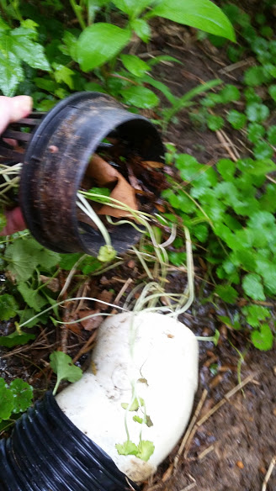
Maintenance
Essential to assure proper function
Weeding is greater in first two years
Mulch helps to keep weeds down
Check inlet periodically for debris
Check during storm events to assure it is draining and holding water properly
If not draining after 48 hours then remediation
Sand wicks

Slide 24
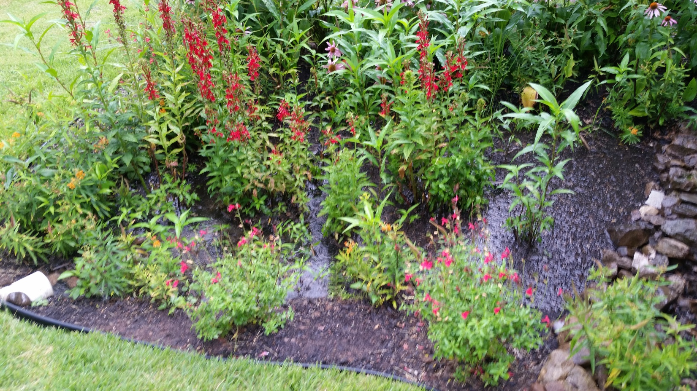
University of Nebraska Resource
Use the Link Above to Calculate Rain Garden Size

Slide 25
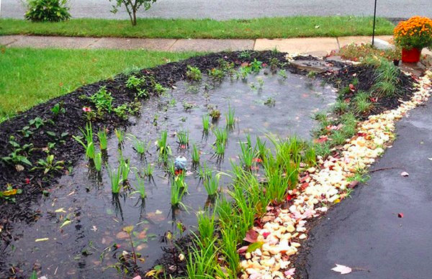
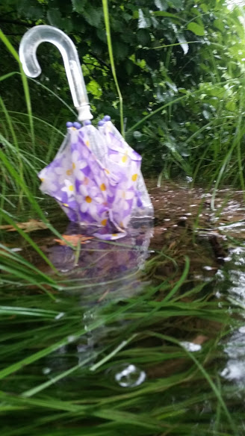

Slide 27
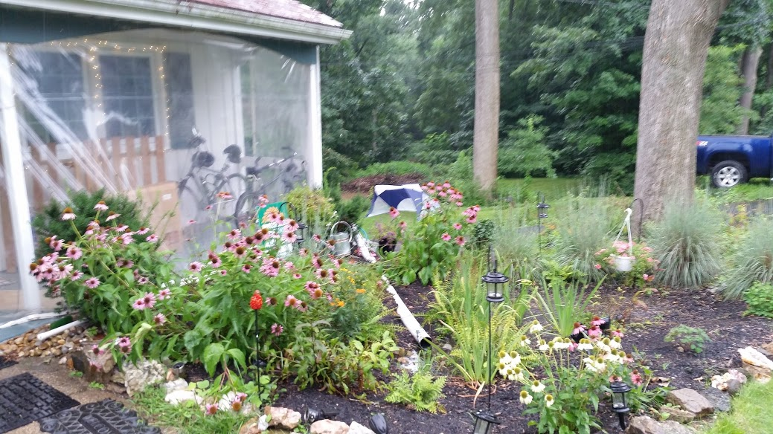

Slide 28
